Slide 1

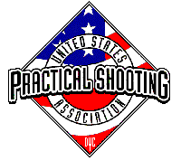
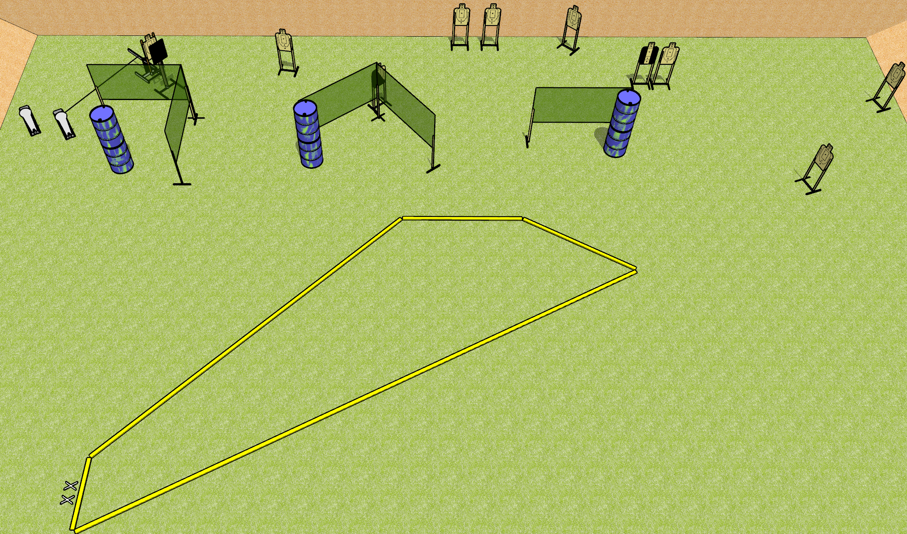
 | Dothan Gun Club – USPSA Match Bobbing Meanie Course Designer : Drew Coleman
Round Count 22 rounds 10 USPSA 2 colt poppers
Equipment List 8 wall feet Bobber + activator 1 medium fault line 1 tux, 1 left diagonal

Slide 2
Bobbing Meanie
Written Stage Briefing
Bobbing Meanie is a 22 round, 110 point, Comstock course of fire. There are 10 USPSA targets and 2 colt poppers. The best 2 hits on paper will score, and steel must fall to score. The start signal is audible.
The bobber is activated by the right colt popper and remains visible at rest. It must be activated before being engaged.
Handgun start position is completely outside the shooting area, feet on X’s, wrists below belt. Handgun is loaded and holstered.
PCC start position is completely outside the shooting area, feet on X’s, stock on belt. Loaded carbine is held with both hands, safety on.
On start signal, engage targets as they become available from within the shooting area.

